Slide 1
Air Pump Matching

Slide 2
Sims

Slide 3
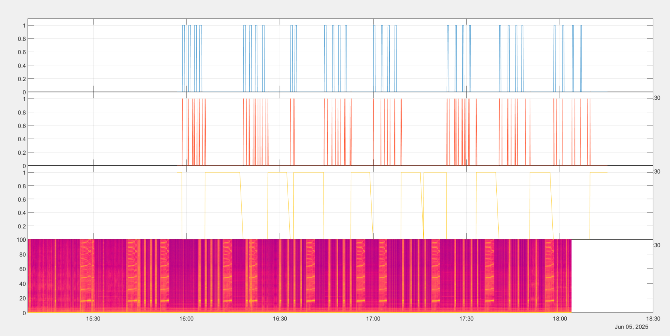
Assuming Glider Clock and DMON clocks are Synced
Ballast Pump
Pitch Motor
Air Pump

Slide 4
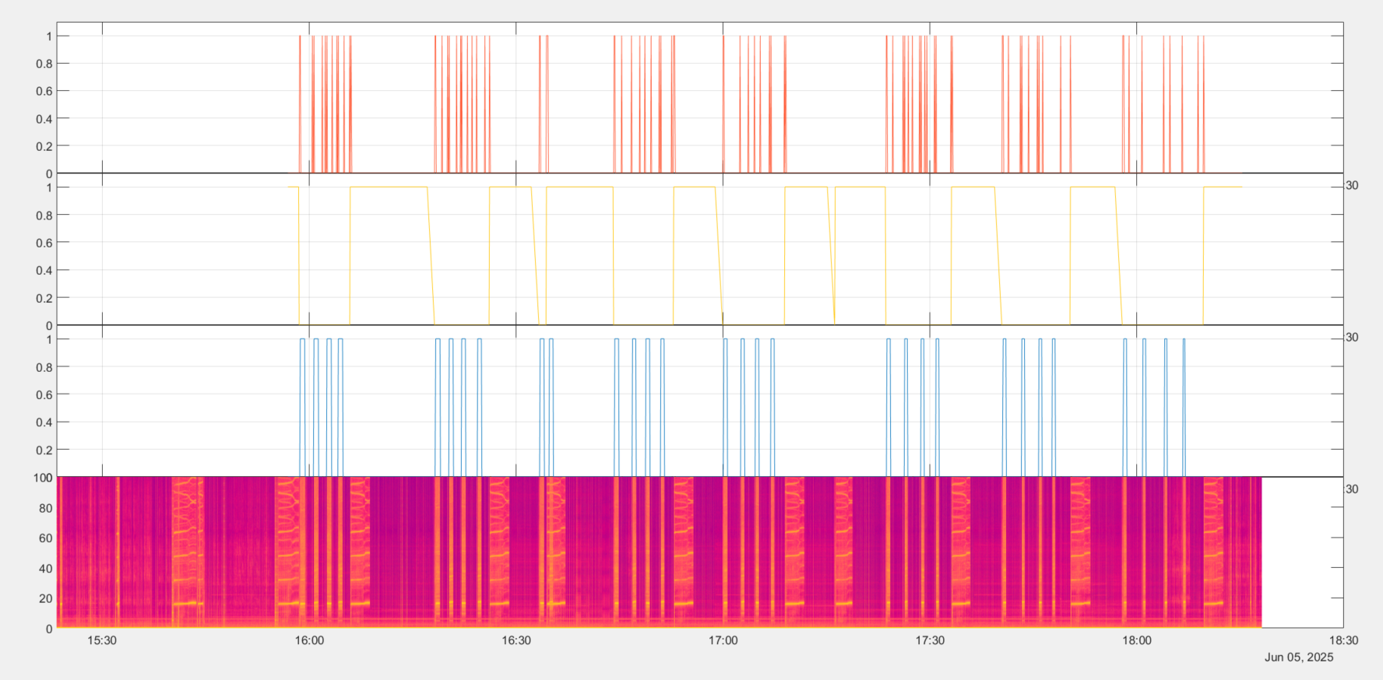
Manual Syncing
Pitch Motor
Air Pump
Ballast Pump

Slide 5
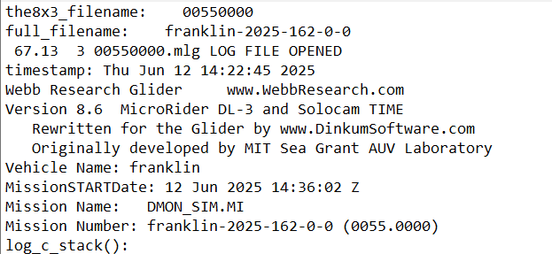

Time difference: ~00:14:25
DMON clock earlier than glider clock
Mission START Date in mlg file is strangely ~00:14:25 ahead of the actual start time (written down from SFMC clock)
Written sim start time is Jun 12 14:21:30 2025
So DMON time is correct and glider (dbd time) is not
DMON
Glider Flight Data

Slide 6
Angus Whale

Slide 7
Plotted entire substruct data on Matlab
Primarily looked for spots with irregular air pump movements, because those are easier to spot on audio

Slide 8
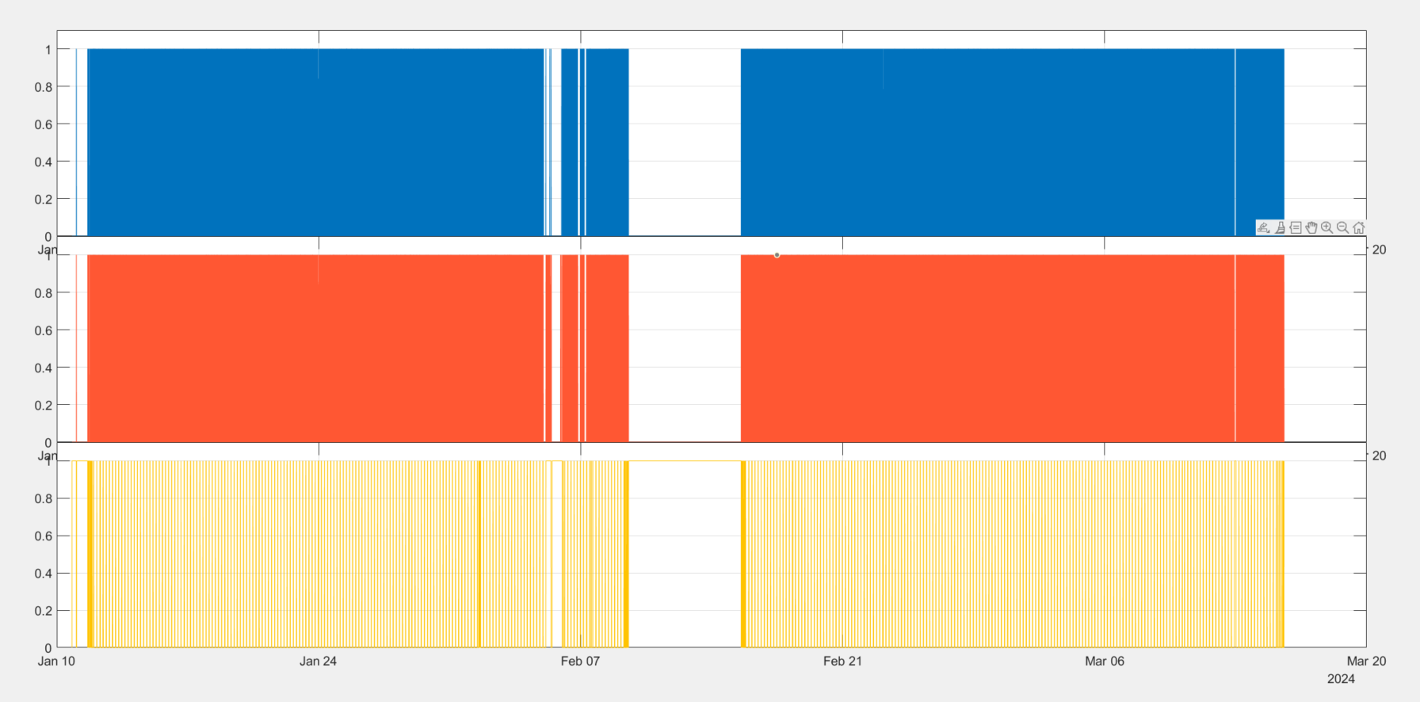
Ballast Pump
Pitch Motor
Air Pump

Slide 9
Feb. 1, 2024
Day with irregular air pump movement
Good spot to check syncing

Slide 10
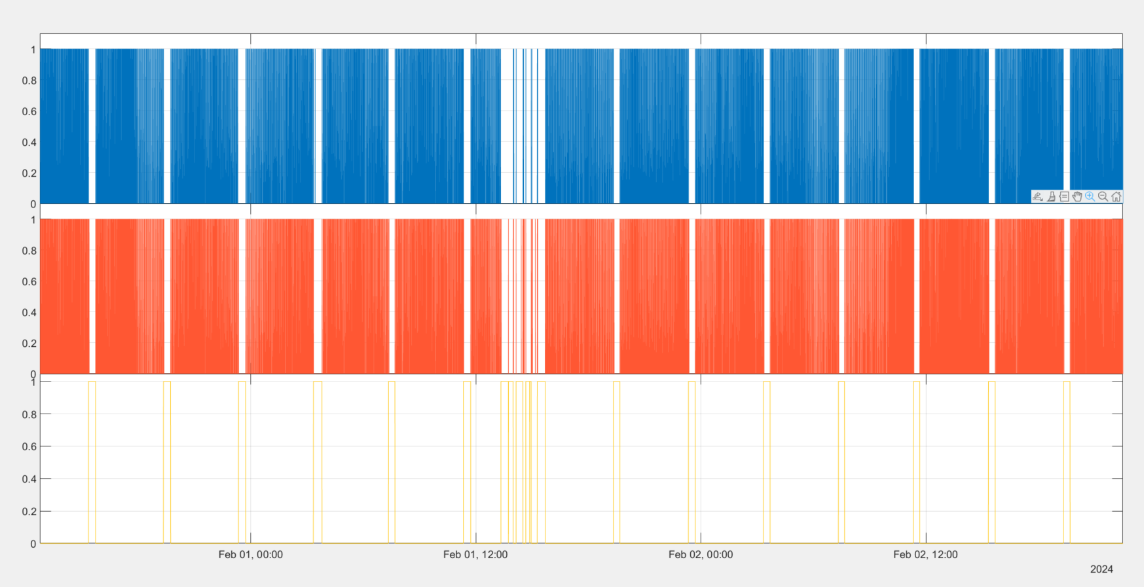
Ballast Pump
Pitch Motor
Air Pump

Slide 11
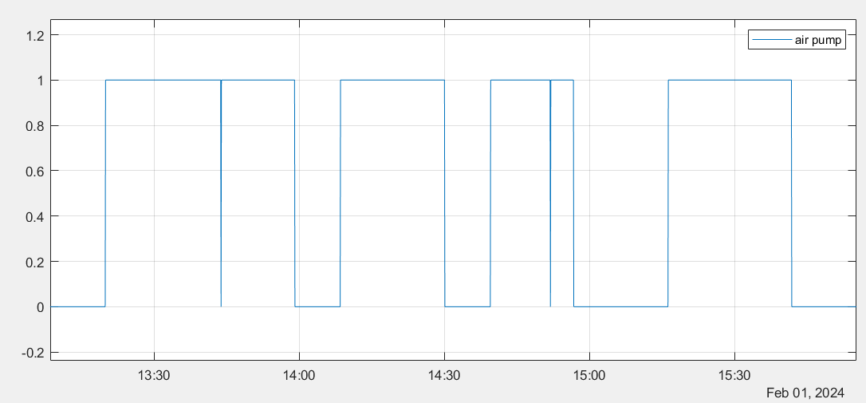

Slide 12
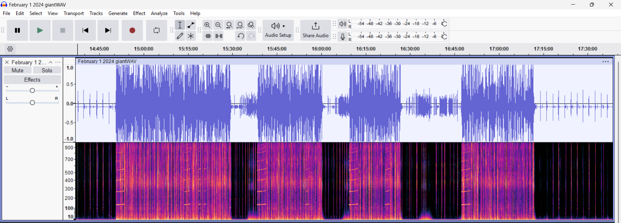

Slide 13
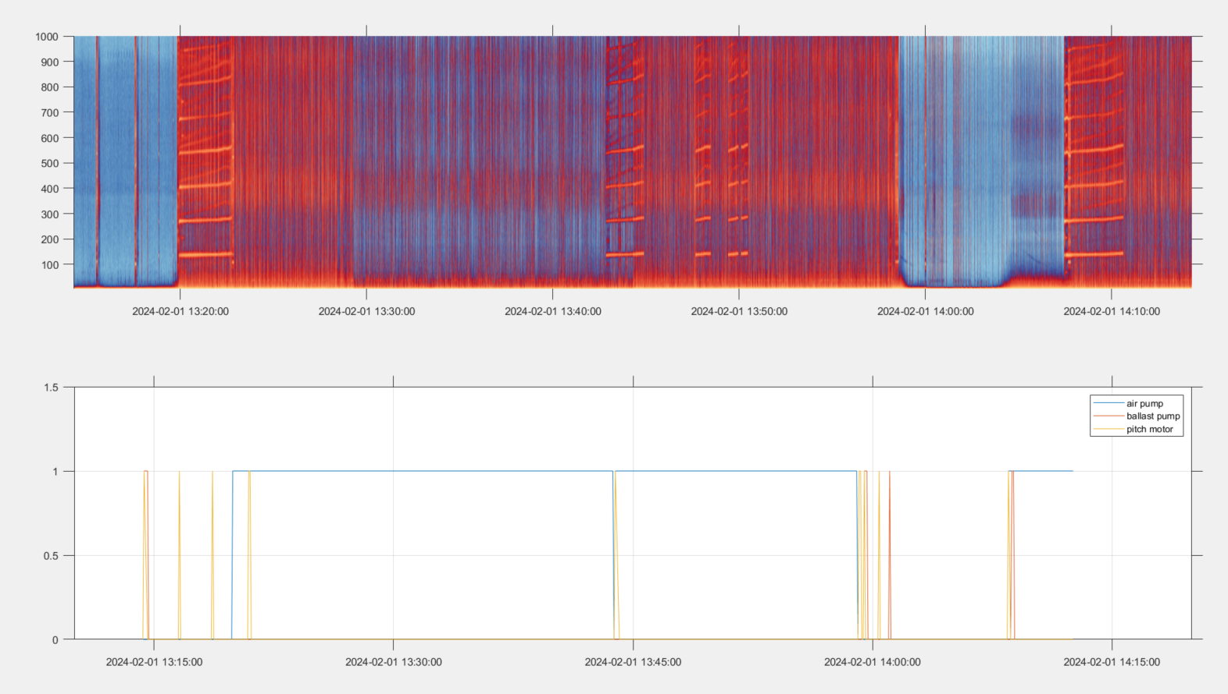

Slide 14
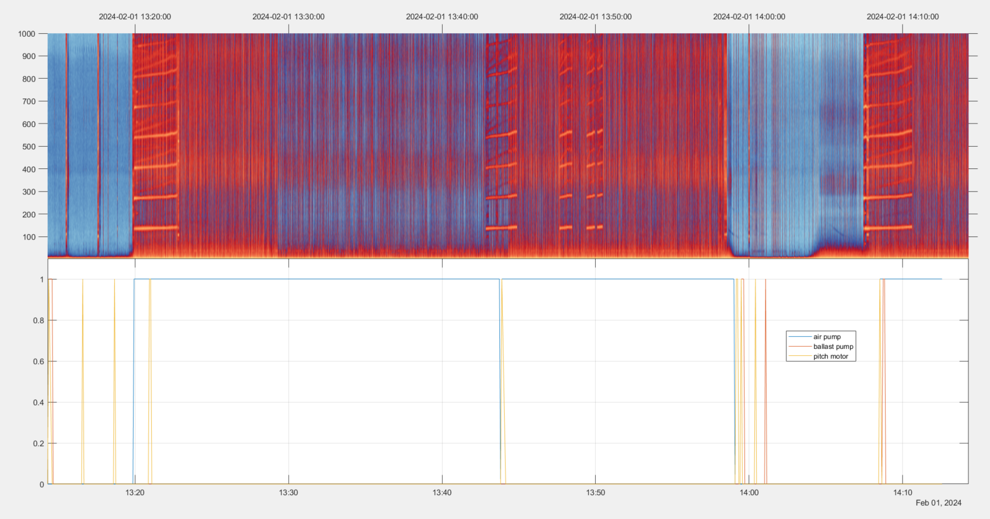

Slide 15
Plots Assuming Glider Clock and DMON Clock Synced

Slide 16
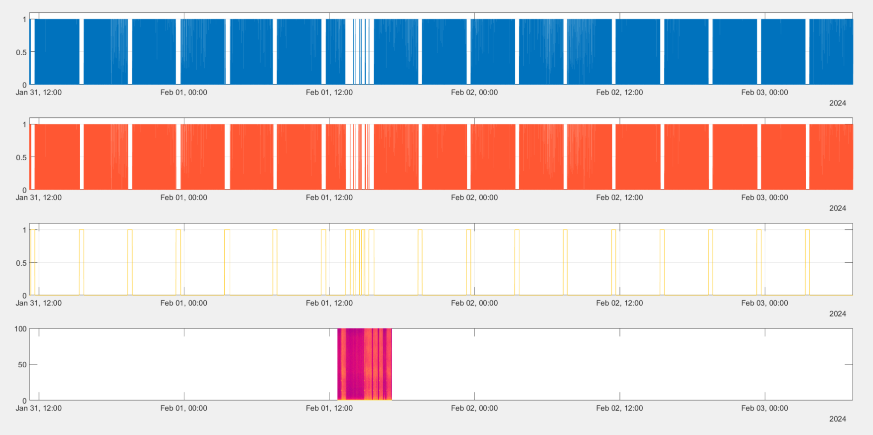
Ballast Pump
Pitch Motor
Air Pump

Slide 17
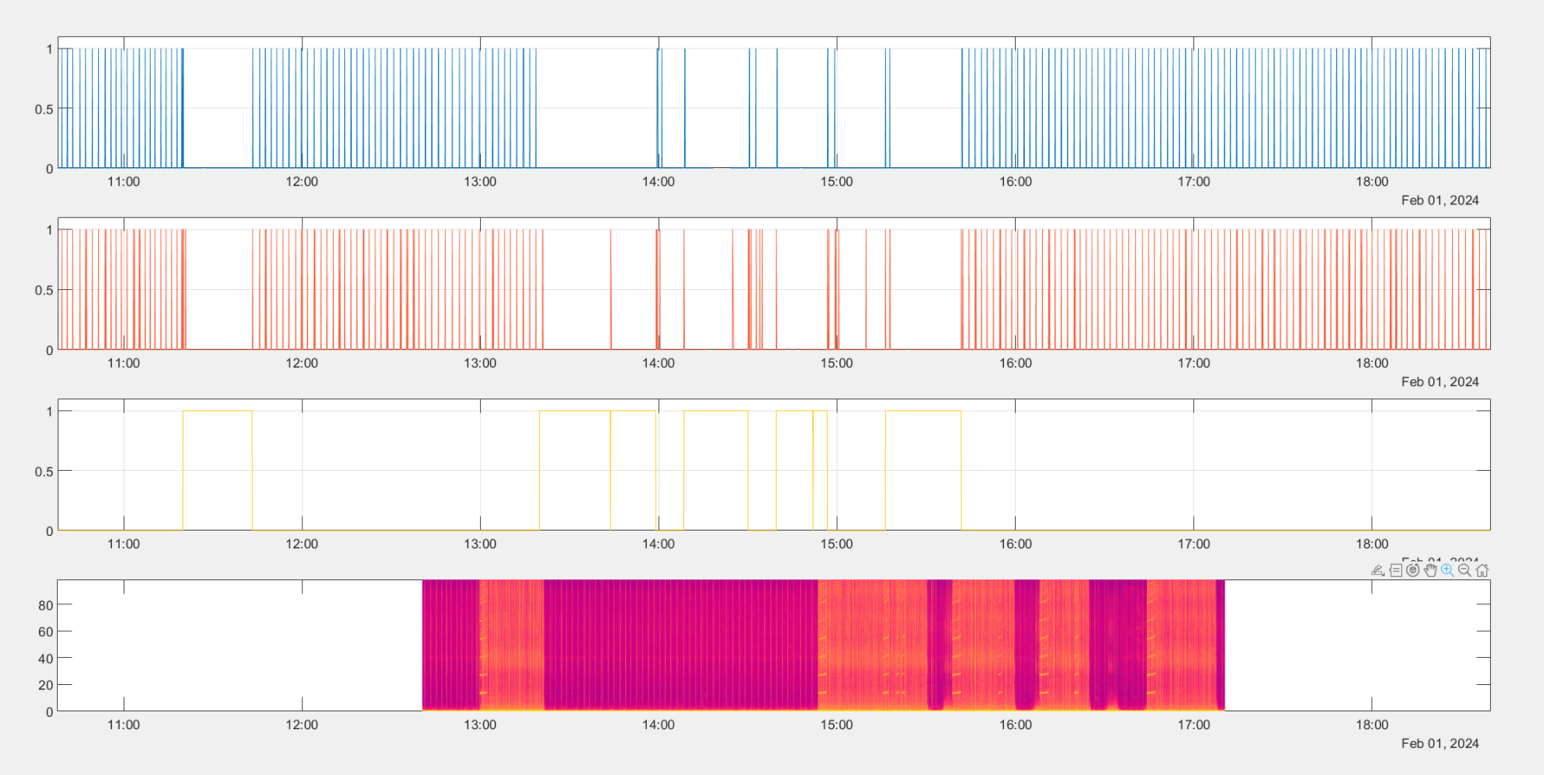
Ballast Pump
Pitch Motor
Air Pump

Slide 18
Manually Syncing Glider and DMON

Slide 19
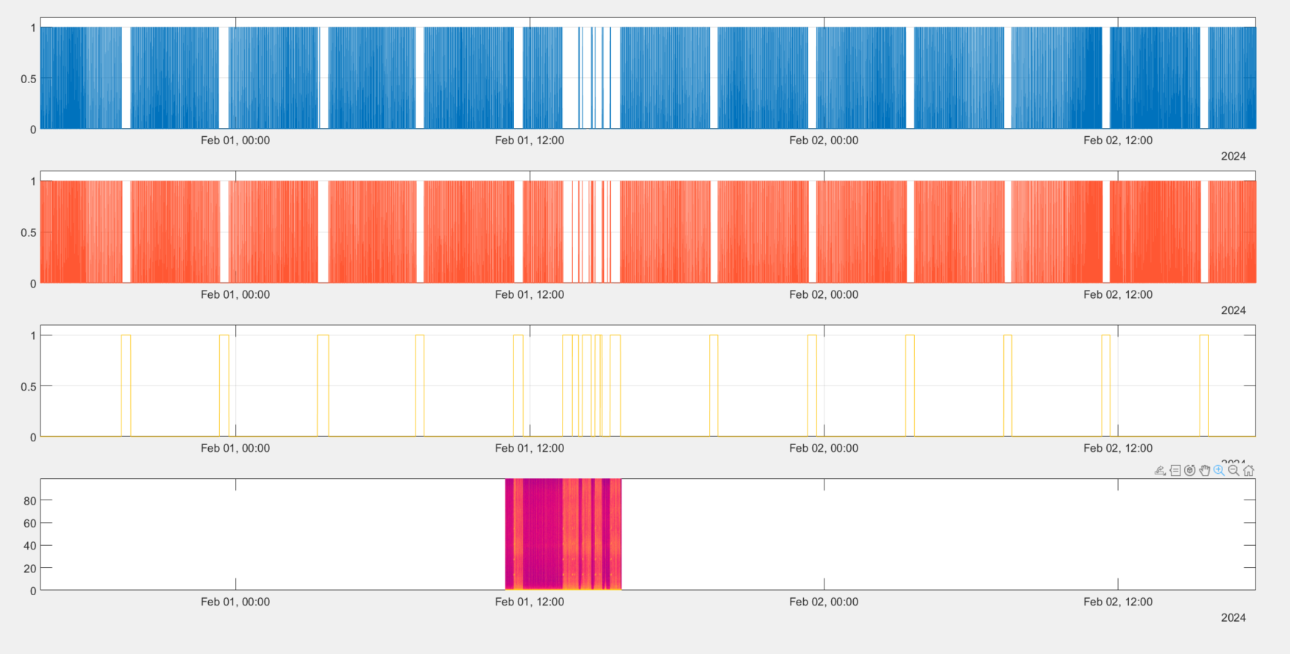
Ballast Pump
Pitch Motor
Air Pump

Slide 20
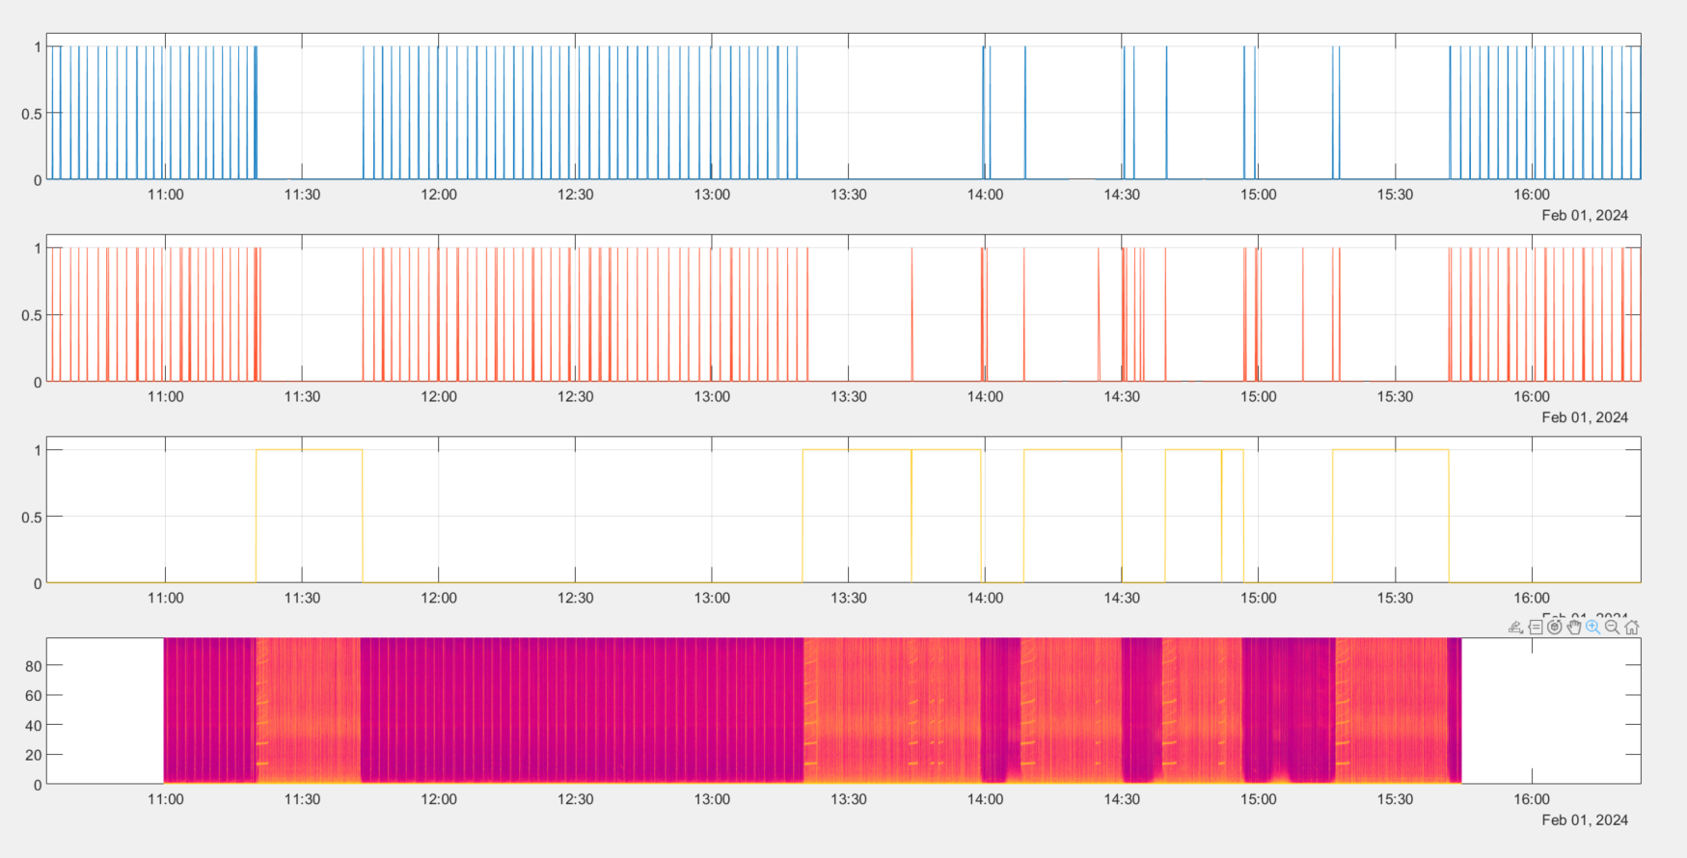
Ballast Pump
Pitch Motor
Air Pump

Slide 21
Glider Flight Data
DMON
Time difference: ~01:40:51
Glider clock earlier than dmon clock

Slide 22
Zooming In

Slide 23
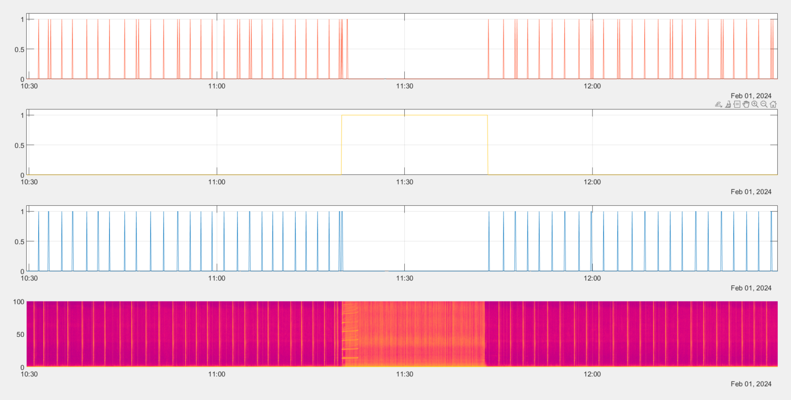
Ballast Pump
Pitch Motor
Air Pump

Slide 24
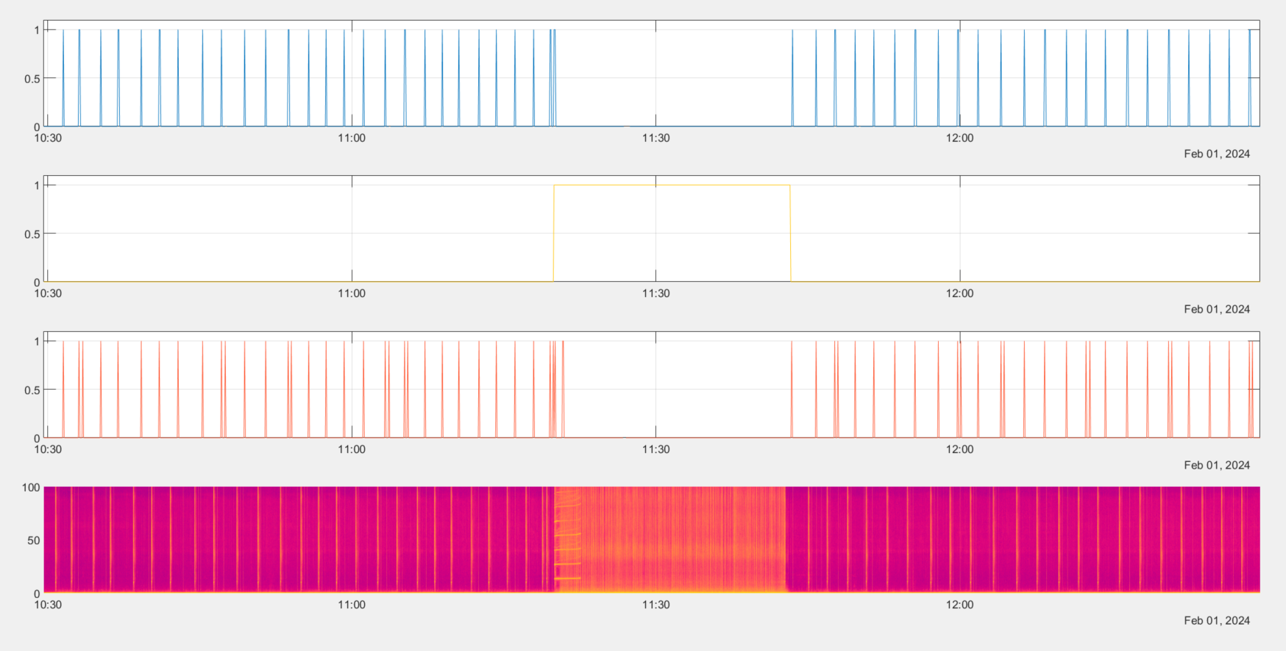
Ballast Pump
Pitch Motor
Air Pump

Slide 25
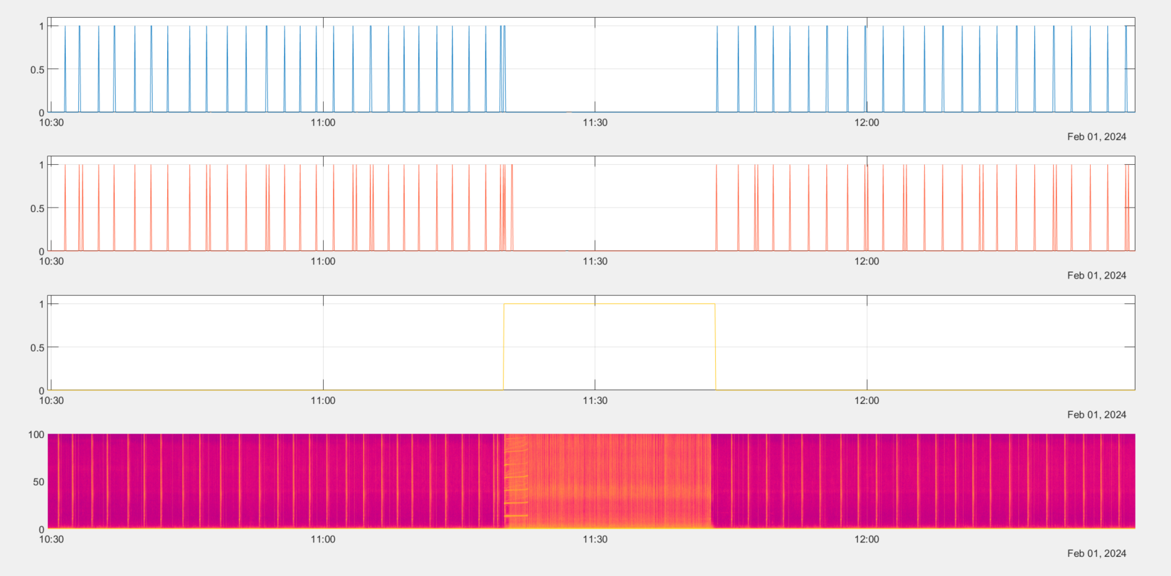
Ballast Pump
Pitch Motor
Air Pump

Slide 26
Air pump part lines up really well
But ballast pump part doesn’t really, at all
Angus whale mission mlgs?
Karen suggested to look at the mlgs where mission aborted and restarted

